Slide 1
Paperless Restaurant App
Coursework 2
Group 3
Connor Partington
David Beattie
Cody Lawson
Luke Mather
Scott Davies

Slide 2
Technologies Used
Throughout the development of the paperless app, several technologies were needed.
Front-end Framework / Presentation Layer – Bootstrap 4
Back-end Framework / Application Layer – Node.js, Express, Various Modules
Database Management System / Data Layer – MongoDB
Middleware – jQuery, Ajax, JavaScript

Slide 3
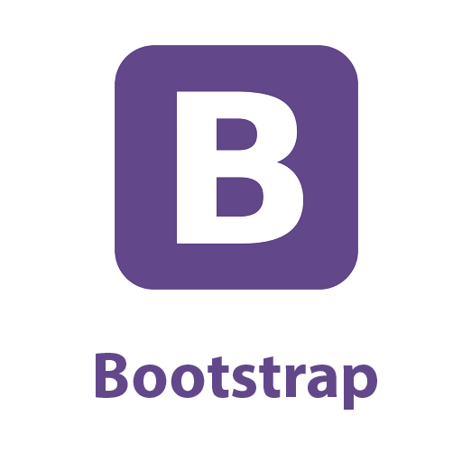
Front-end Framework
Bootstrap 4
Easier and faster web development
Includes HTML and CSS based templates for many different designs
Gives the user the ability to easily create a responsive design
A responsive design is about creating a web page that responds automatically to adjust themselves to look appropriate on all devices ranging from mobile devices to desktop computers.
We used bootstrap because if the waiters would be using either a tablet or mobile device to create orders then the view for each of the different devices would be similar in layout.
With the automatic response the view would not be affected by what device it is being viewed on. It will be the same throughout the restaurant because the kitchen view maybe displayed on a bigger deice so that the kitchen staff can view it easily.
Then within the admin view, this may be displayed on a desktop device, so the view would be automatically adjusted.

Slide 4

Back-end Framework
Node.js, Express
For the back-end framework we used a variety of applications. Node.js, express and various other modules all working cohesively to provide back-end support for the application.
Node is designed to build scalable network applications. Many connections can be handled concurrently. Upon each connection the call back is fired, but if there is no work then node will sleep.
Express is an open source minimal and flexible Node.js web application framework that provides a robust set of features for web and mobile applications.
We used these different modules to develop a link between each view. We used various events and call backs so that is why node.js and express was used.

Slide 5
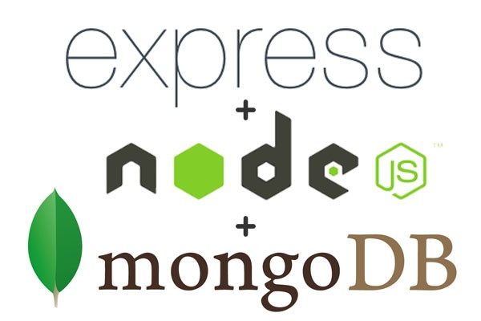
Database Management System
MongoDB
For the database management system, we used MongoDB. MongoDB is a cloud-hosted database service. MongoDB stores data in flexible, JSON-like documents, meaning fields can vary from document to document and data structure can be changed over time. MongoDB is free and open-source
We used MongoDB as our database source because it is open-source and works with JSON documents with JavaScript being used inside our coding. With this being heavily reliant on the server-side, MongoDB is the easiest to use and being open source, this is application can be used anywhere.

Slide 6
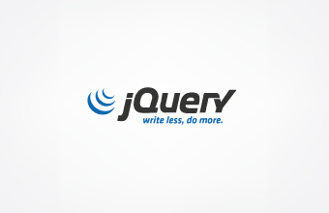

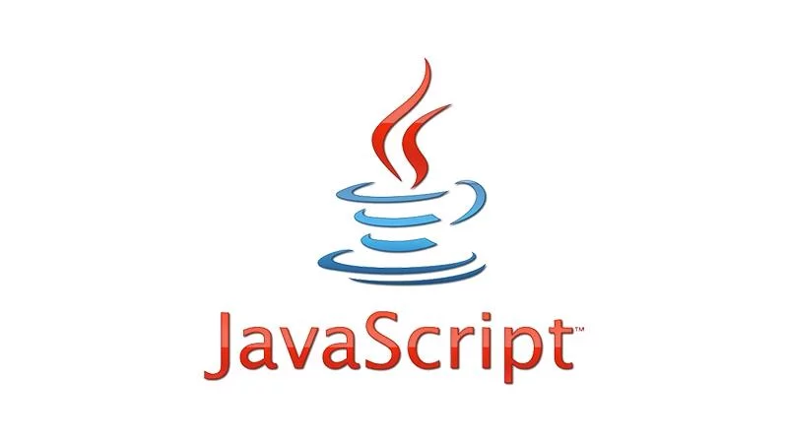
Middleware
JQuery, Ajax, JavaScript
Middleware is the software used to bridge an operating system or database to an application on a network. With MongoDB being used as a server-side and the front/back-end framework needing to link together for our application to run. We used JavaScript, jQuery and Ajax languages to link client-side and server-side together.

Slide 7
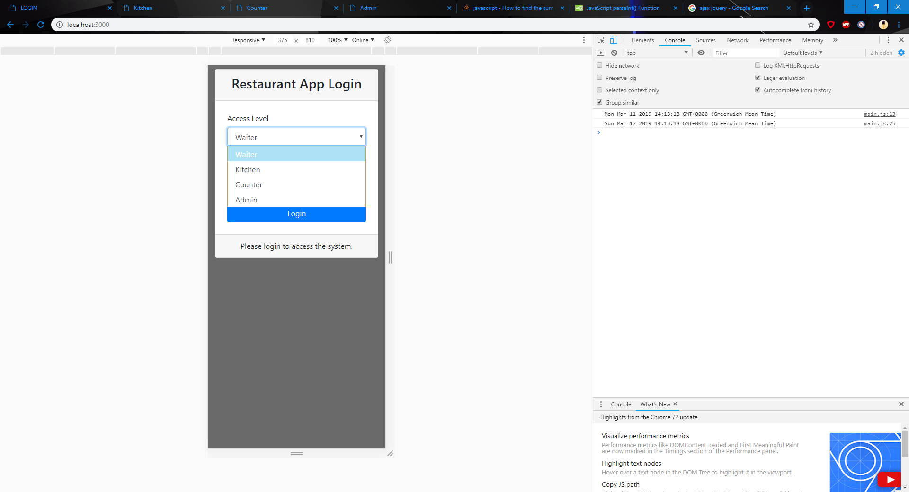
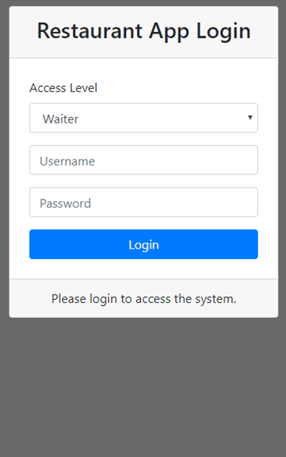
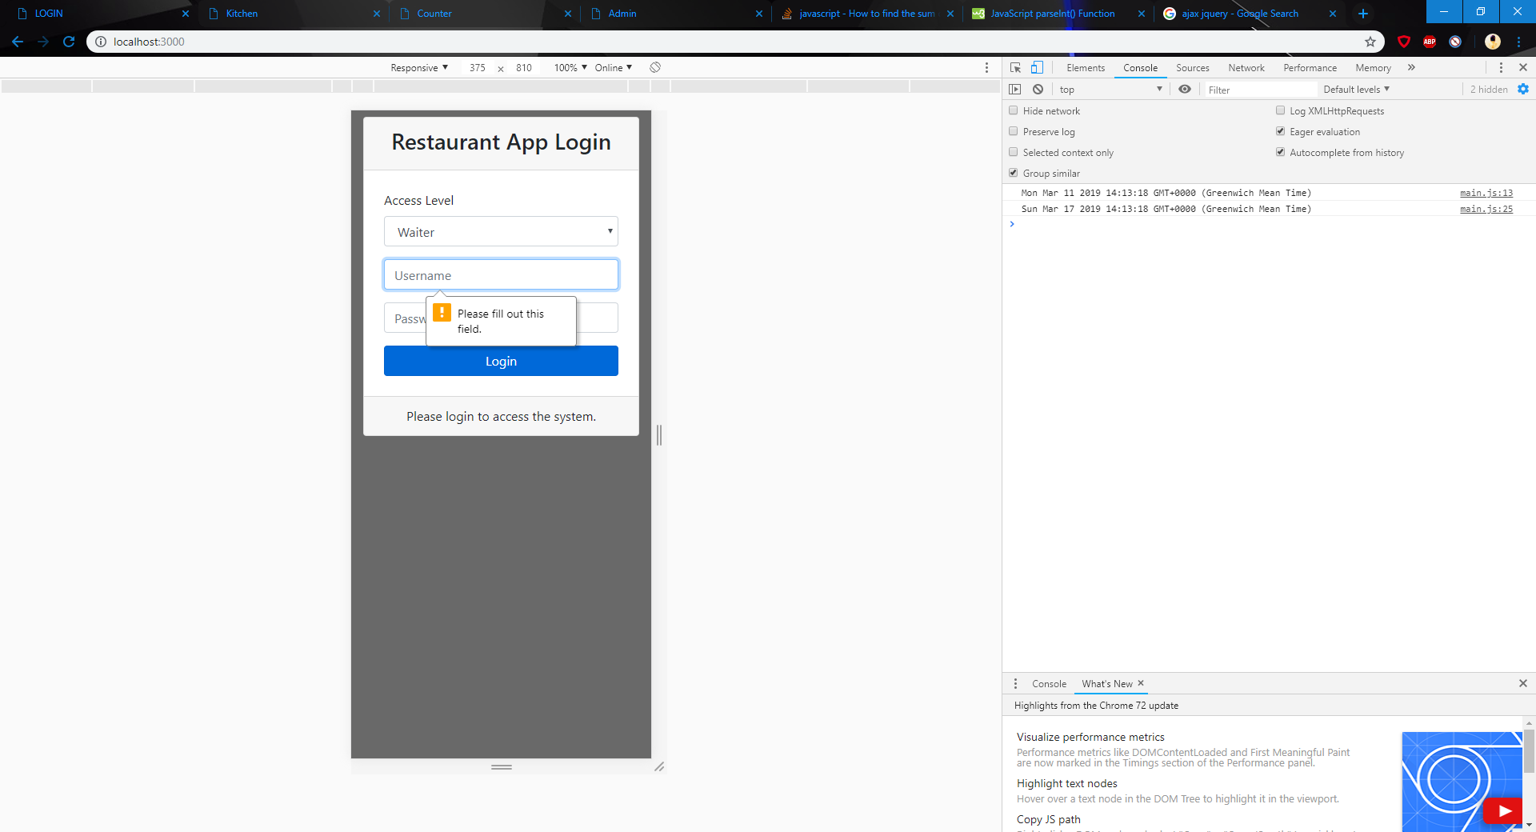
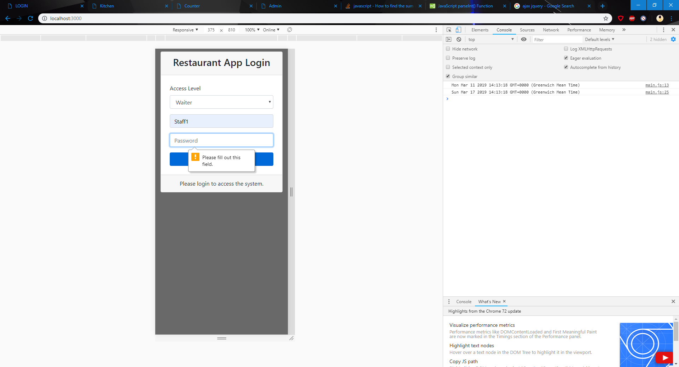

Login
Multiple Access Levels
Username + Password
Client-side validation
Sever-side validation
Fully Responsive

Slide 8
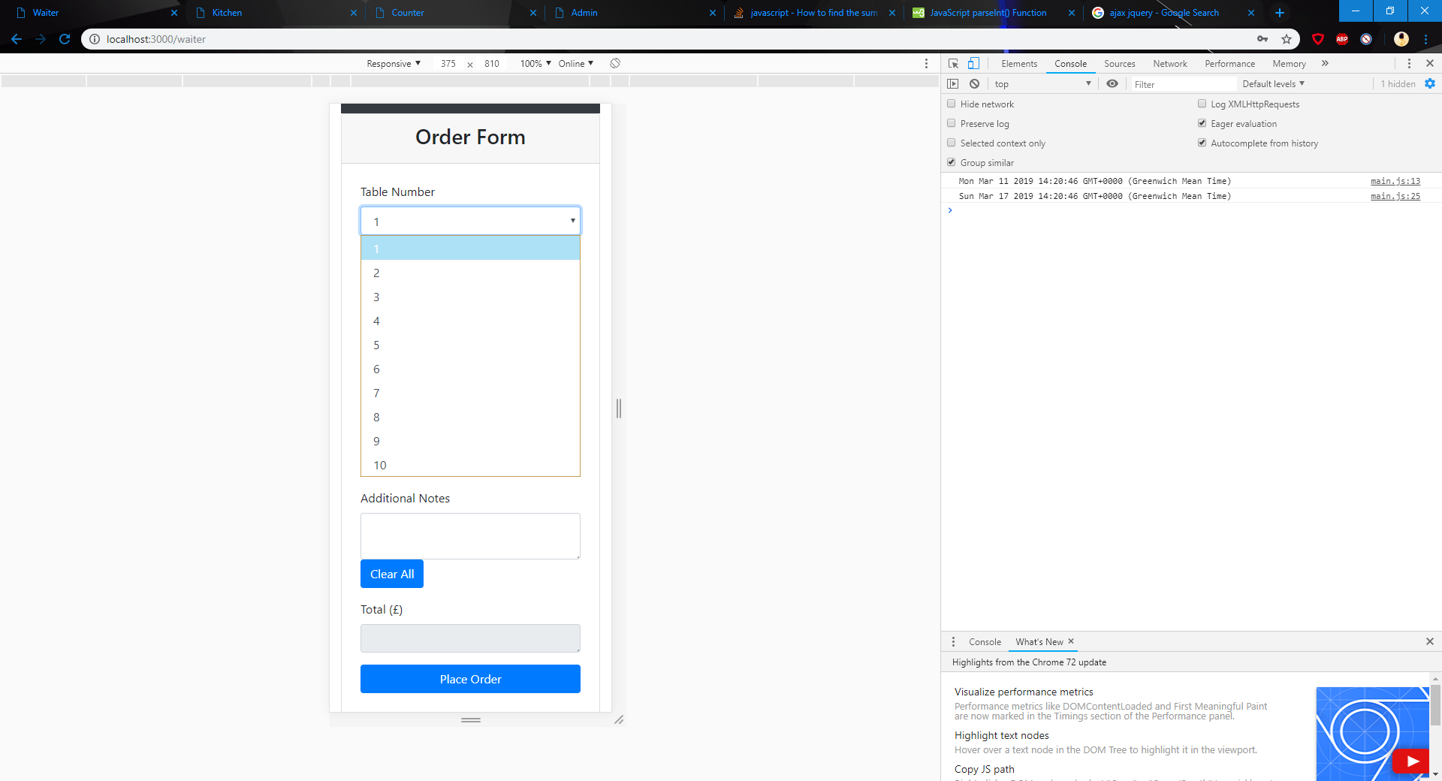
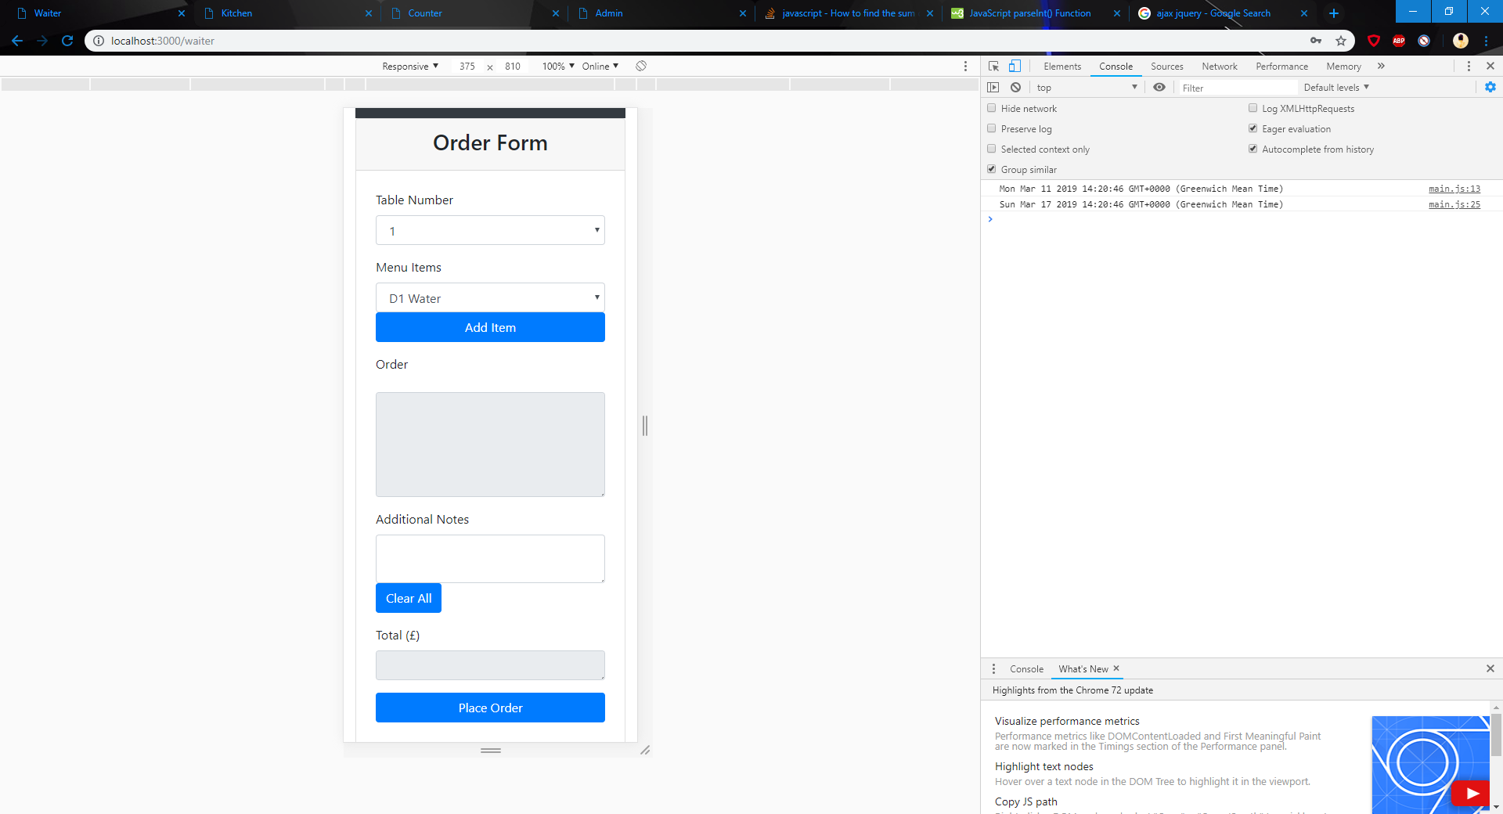
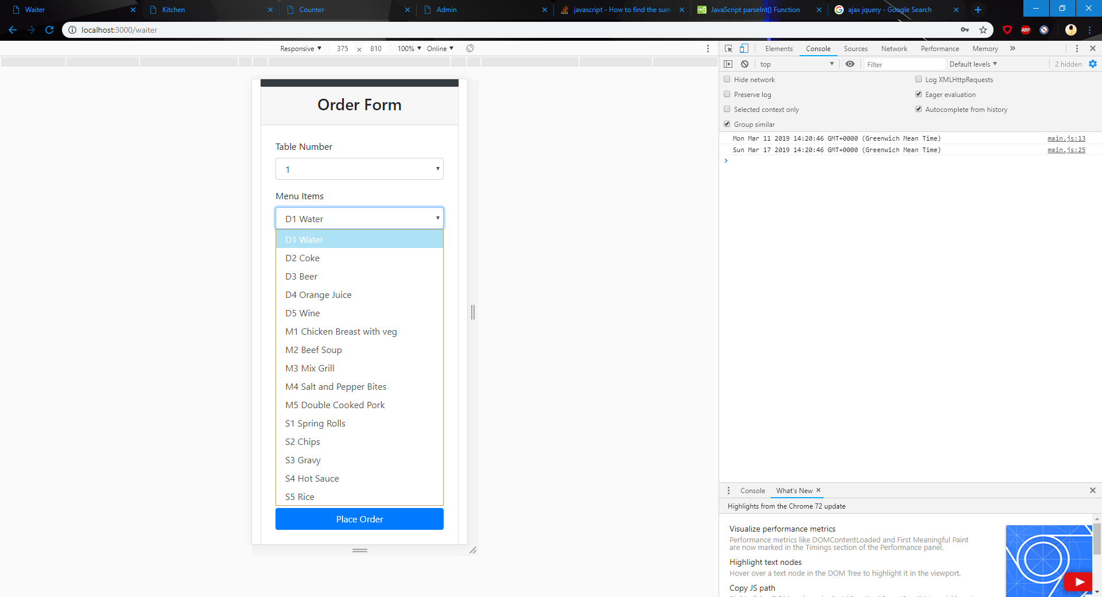
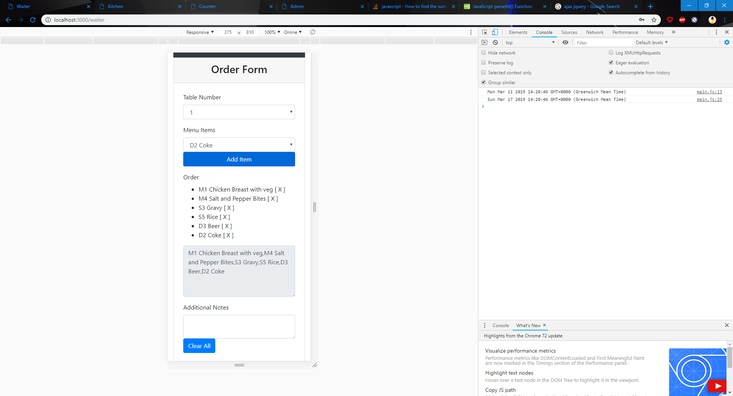
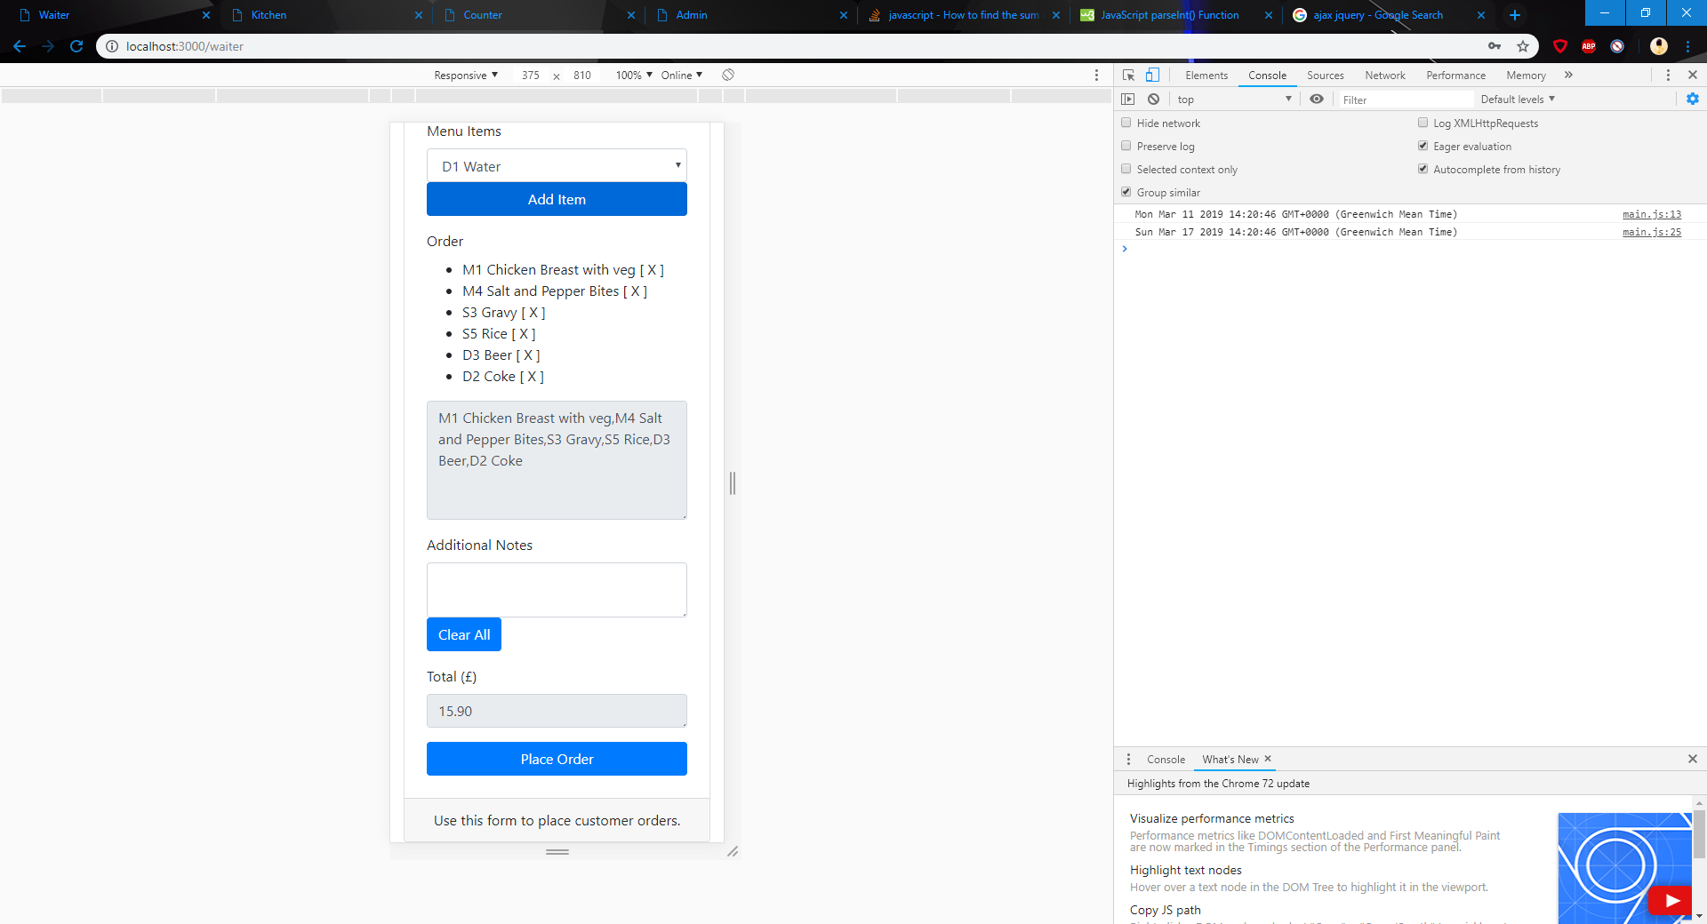
Waiter View
Table Selection
Menu Item Selection
Dynamically updated menu
Asynchronous
Ability to delete items
Order Preview
Dynamically updated total cost

Slide 9
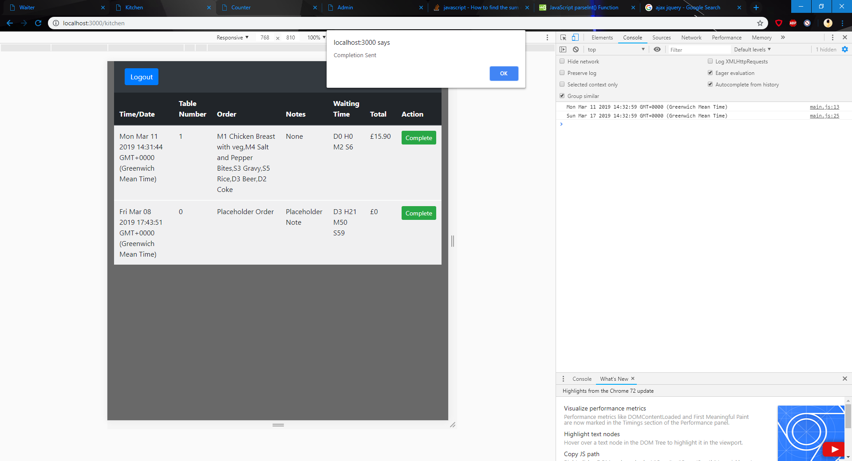
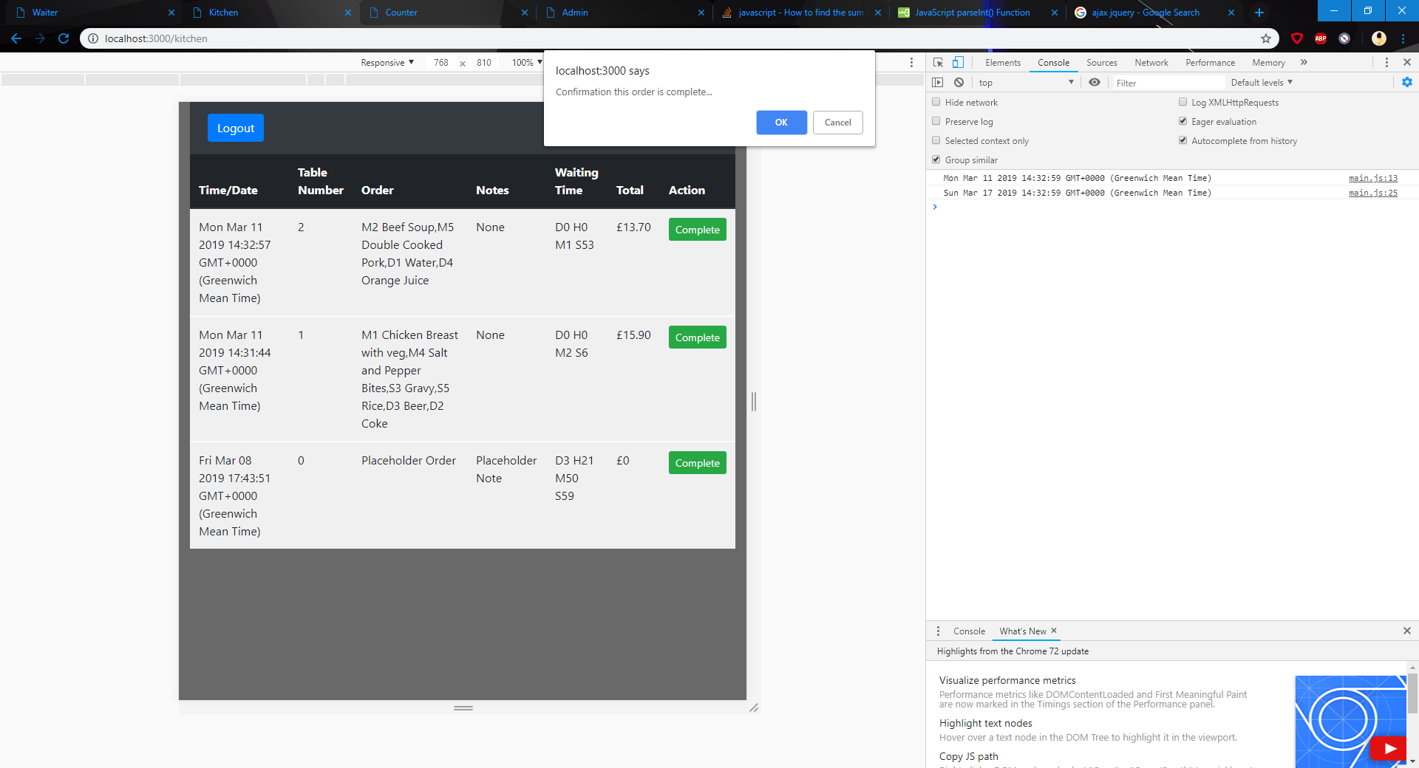
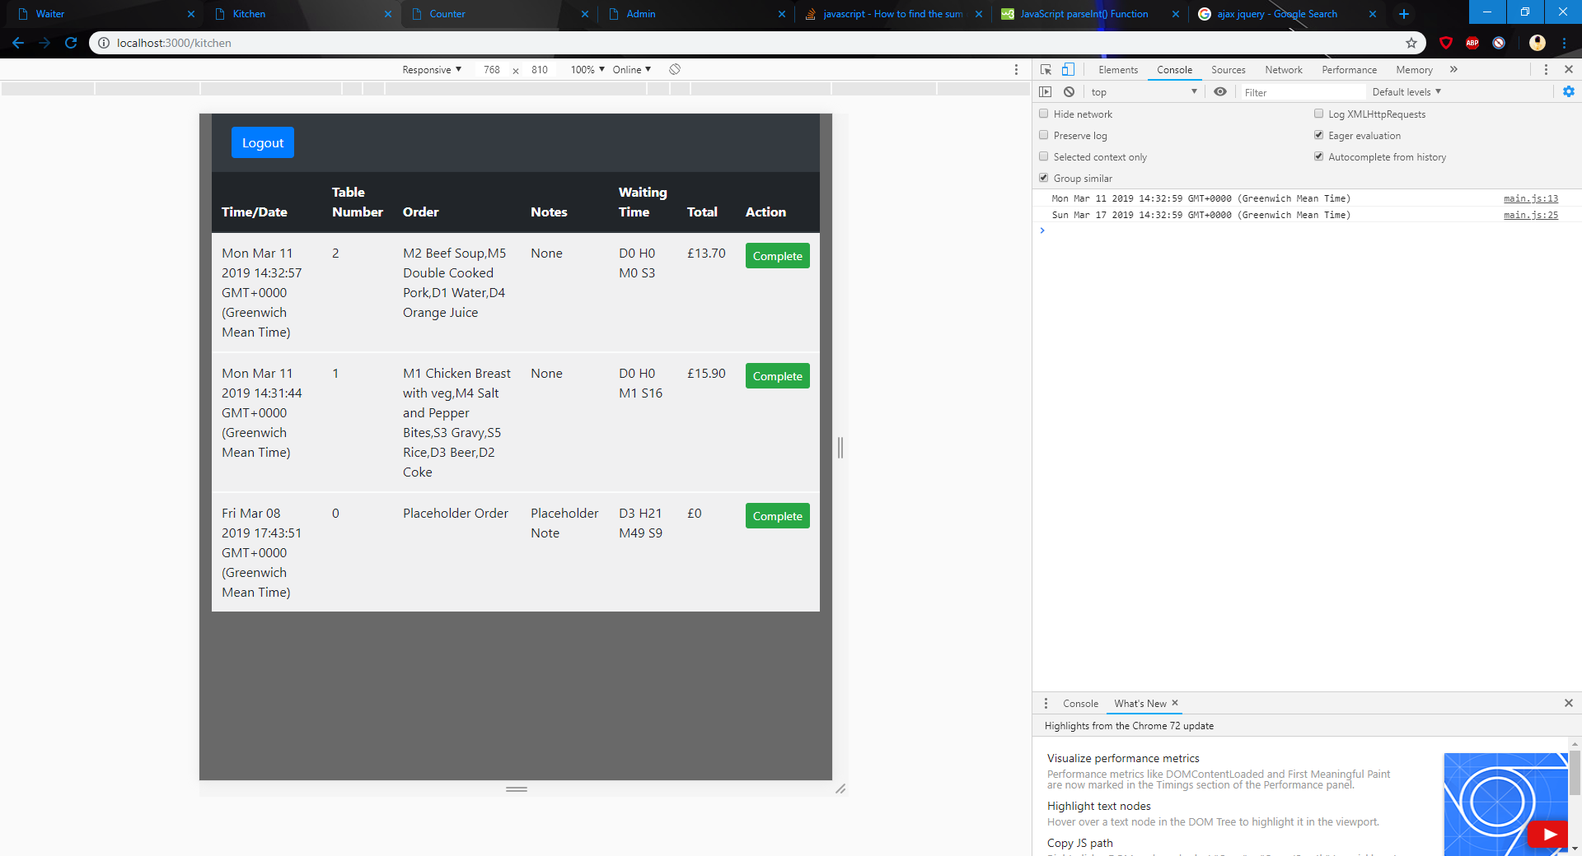
Kitchen View
Simple and clean layout
Confirmation messages
Dynamically updated table and Waiting Time
Partially Responsive

Slide 10
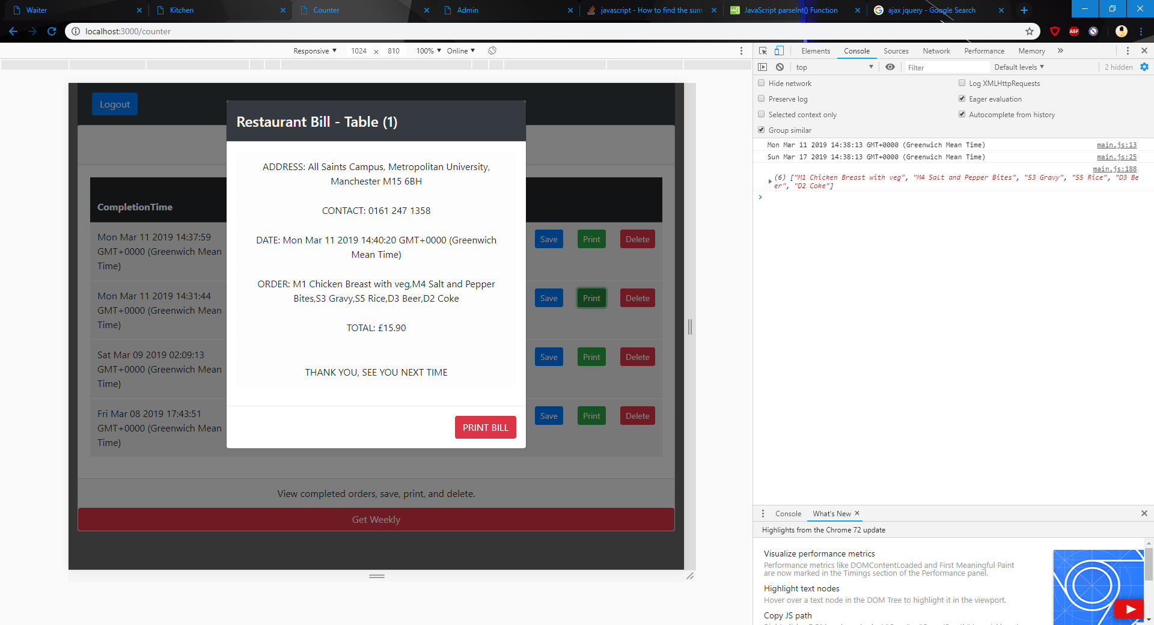
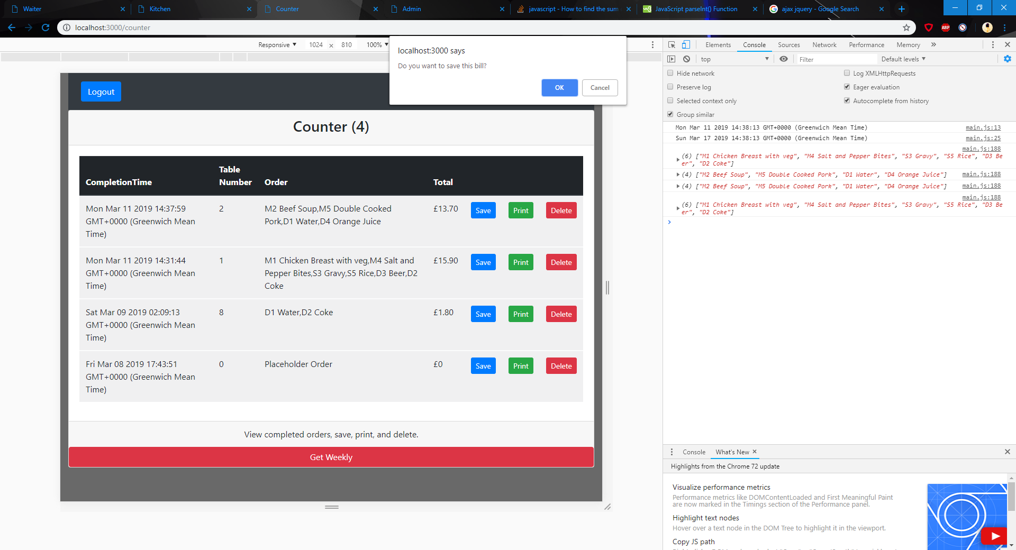

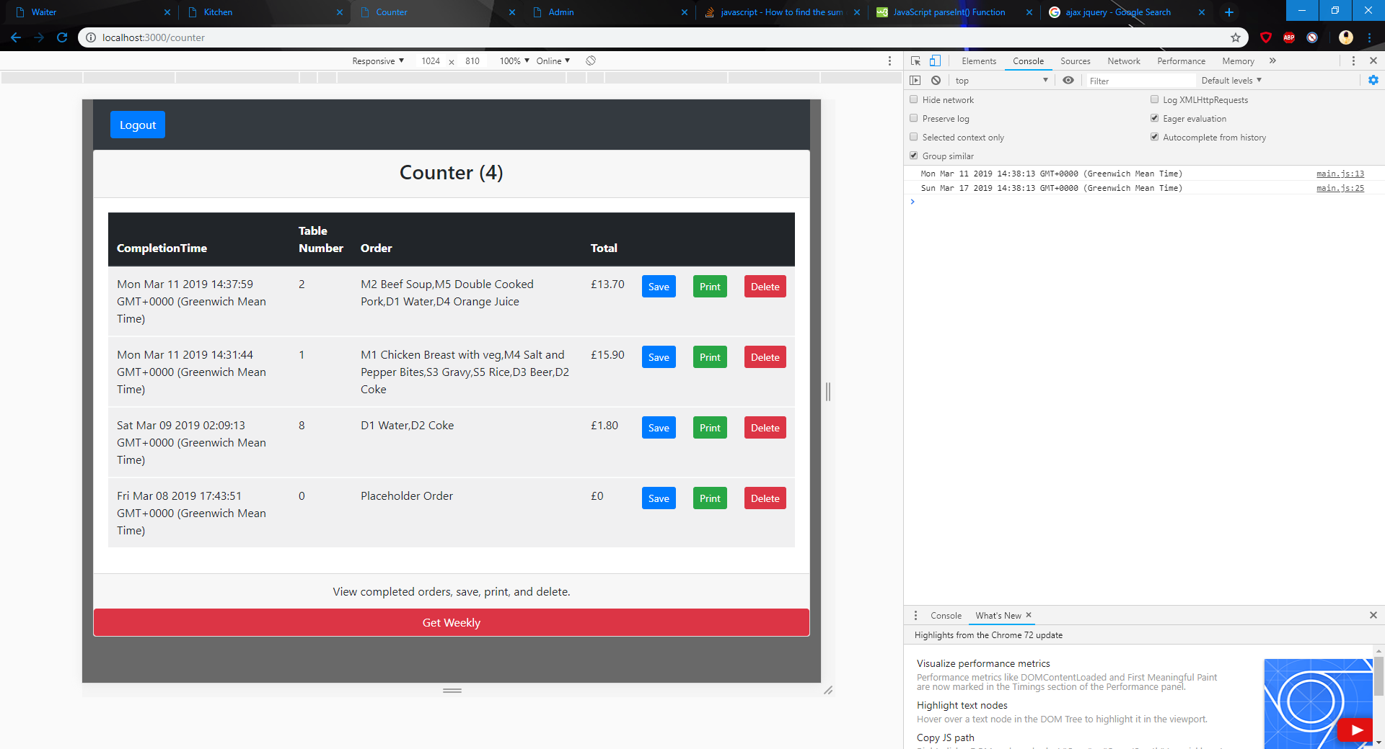
Counter View
Ability to save, print, and delete completed orders
Print displays preview and then another tab for printing as .pdf file
Dynamically updated
Confirmation messages

Slide 11
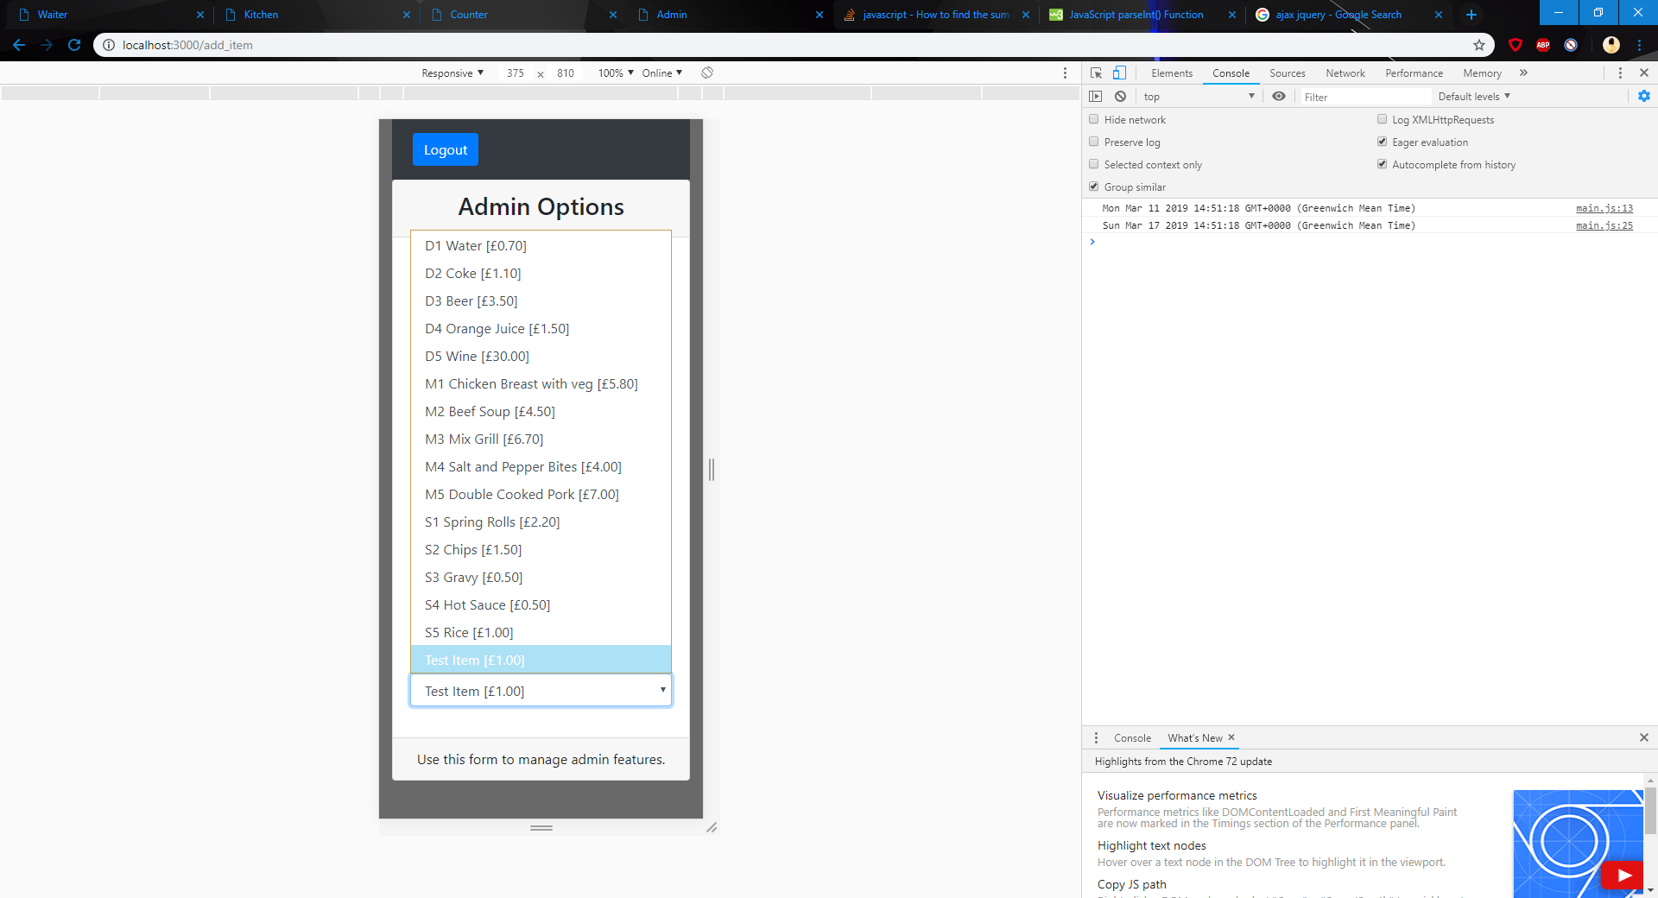
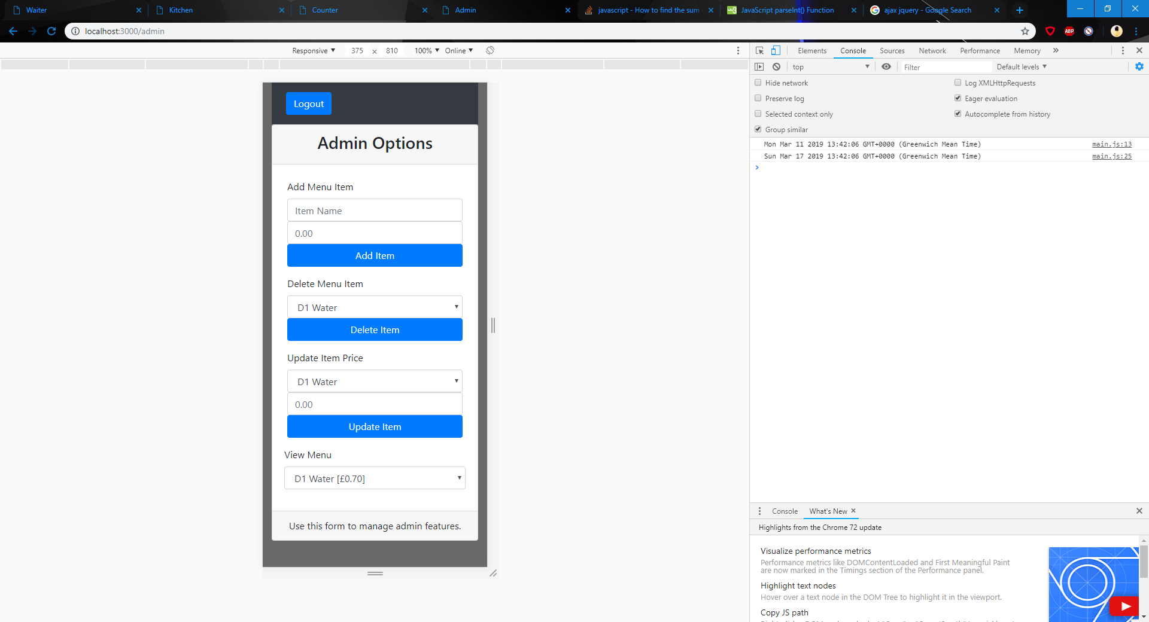

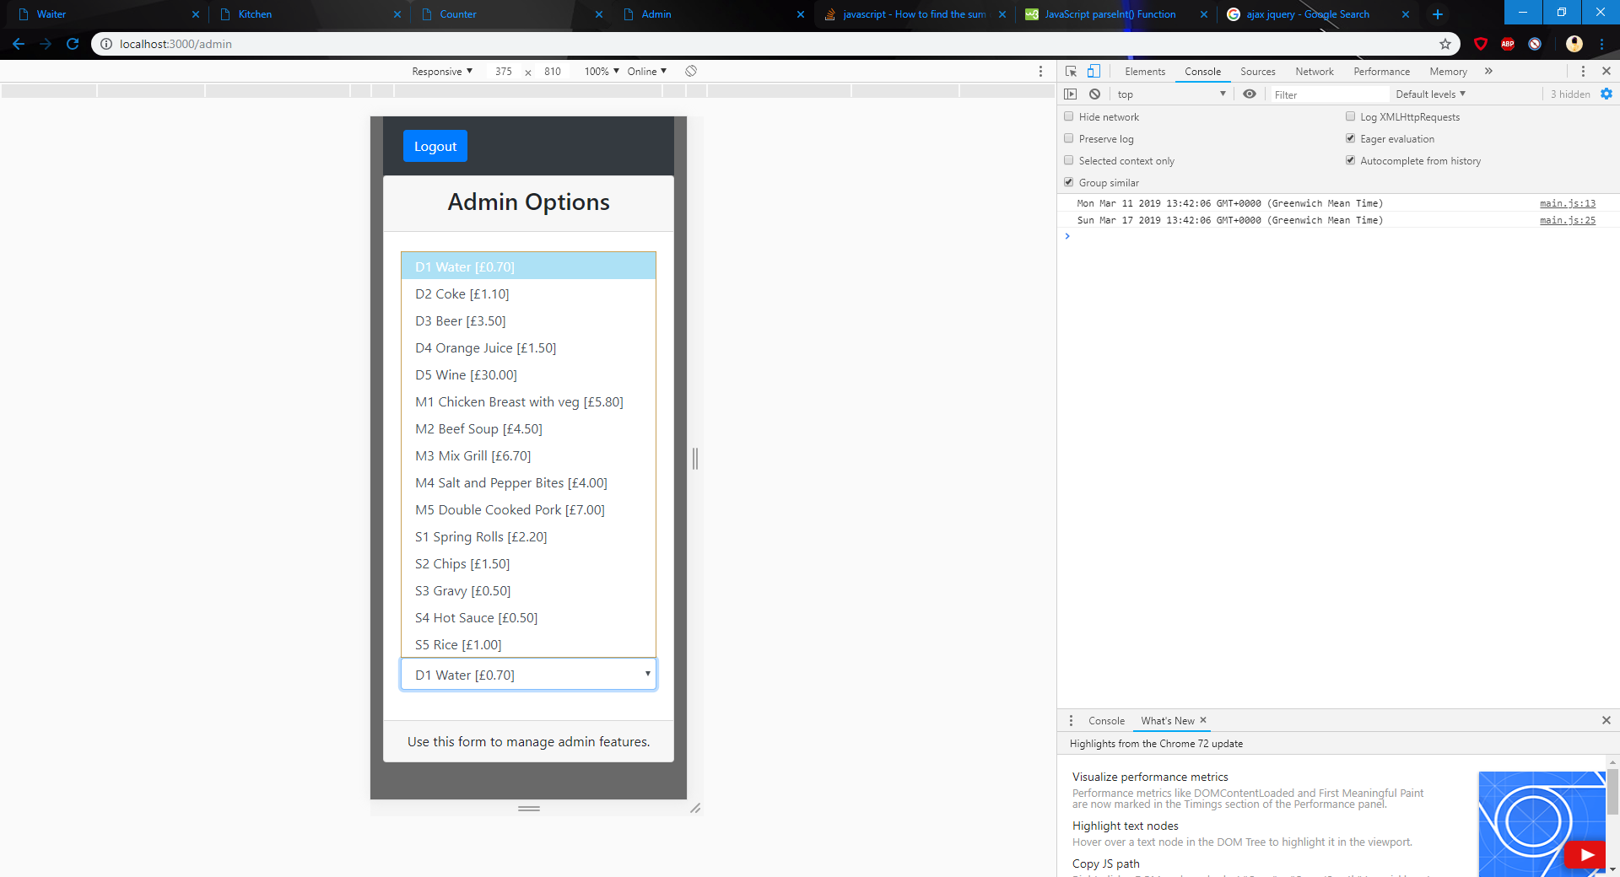
Admin View
Ability to add, delete, and update menu items
Dynamically updated
Full menu and prices can be viewed
Updates waiter view with changes

Slide 12
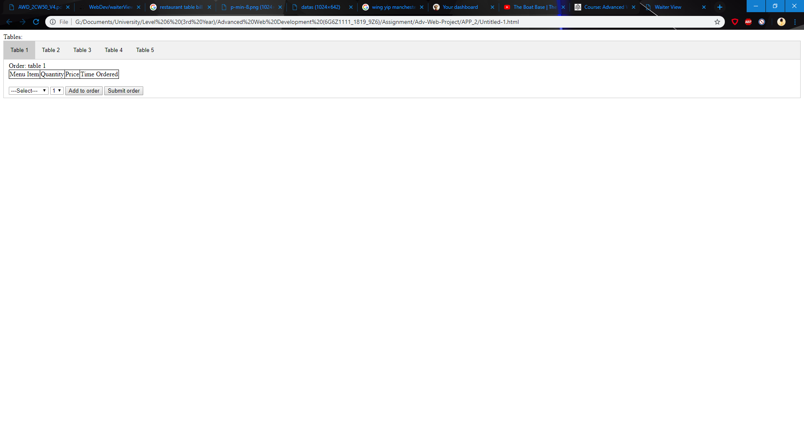
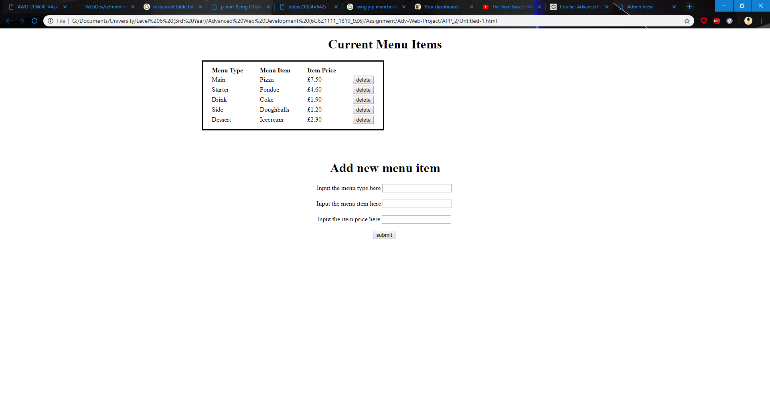
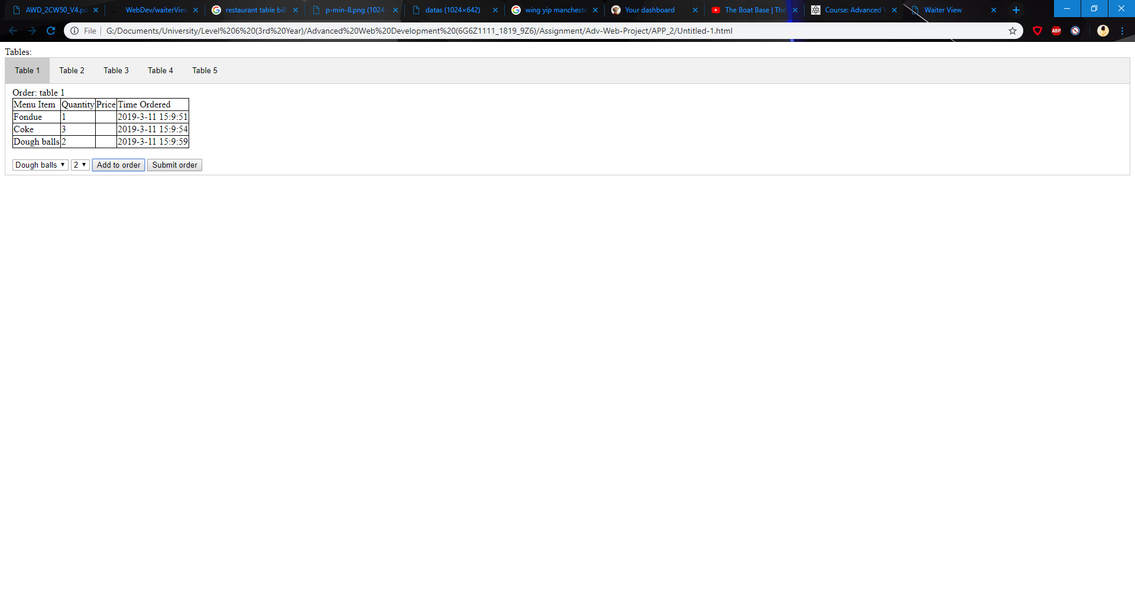
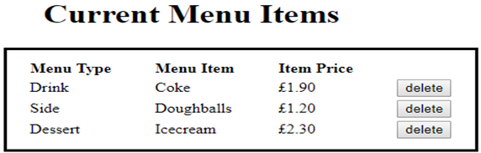
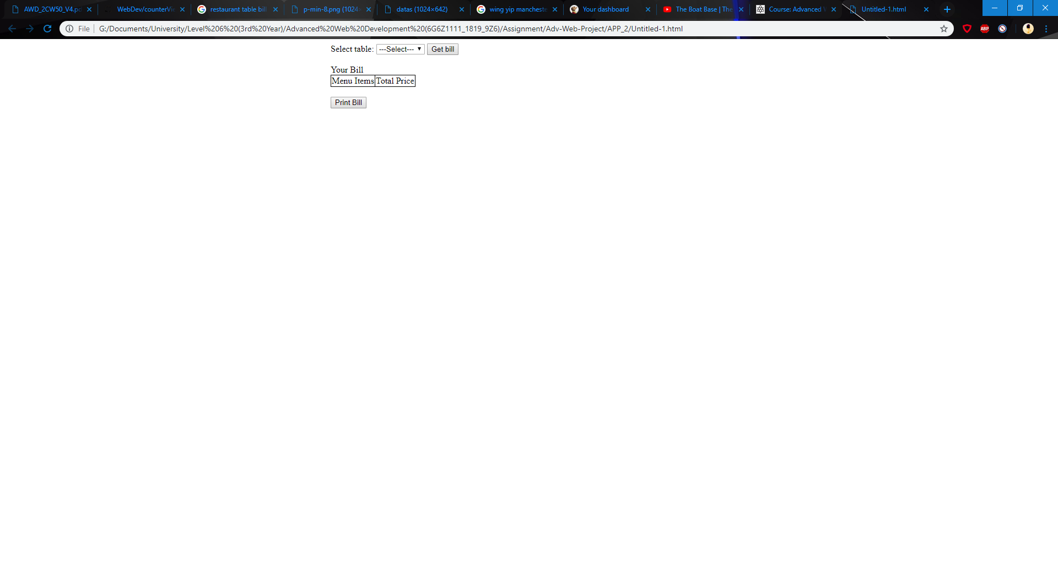
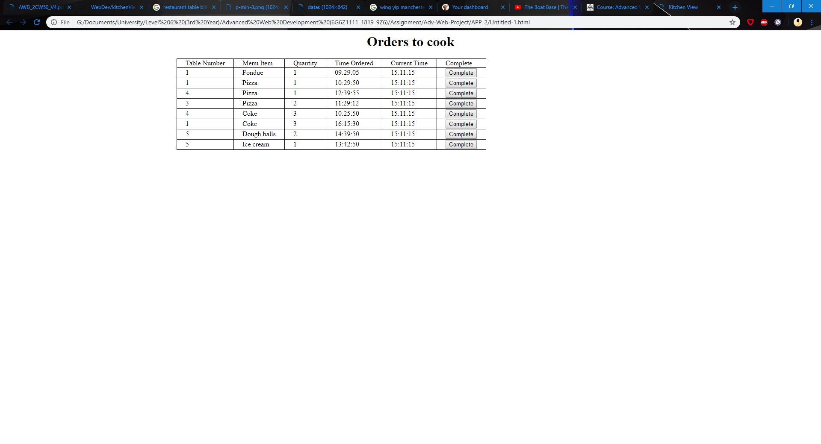

Alternatives
Front-end development
Used HTML, CSS, JavaScript
Waiter view used a tabbed pane idea to switch through the tables
Counter view featured a print preview for the bill (Preview Next Slide)
Admin view allowed adding and deleting items
Kitchen view allows completing cooked orders

Slide 13
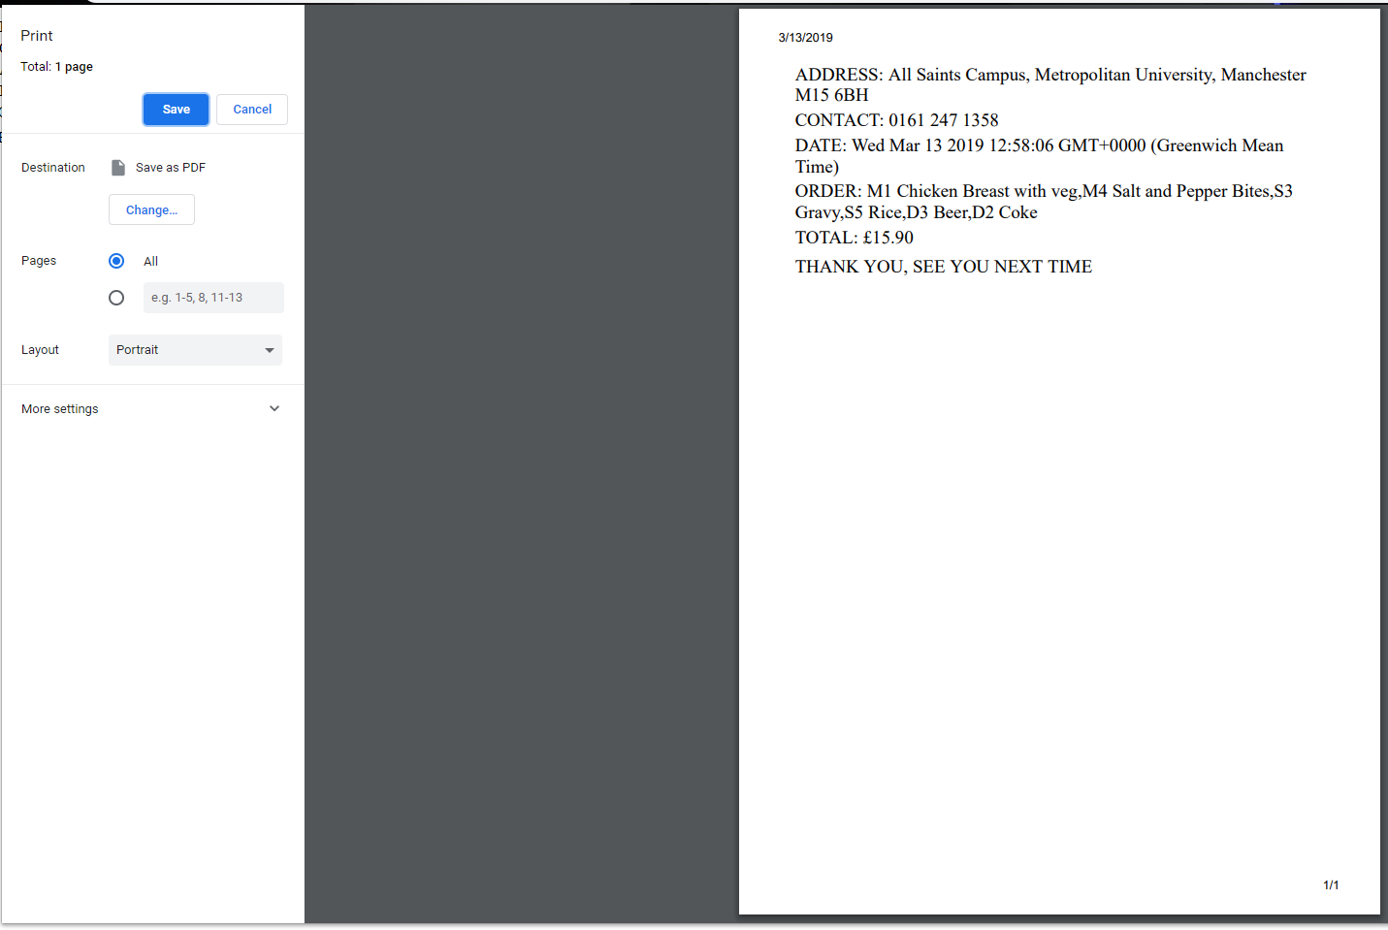
Extra
This is what happens when you press the ‘PRINT BILL’ button in the counter view, when you press the button you are taken to the page shown that lets you print out the bill with ease.

Slide 14
Thank you for listening! Any Questions?

